Slide 1
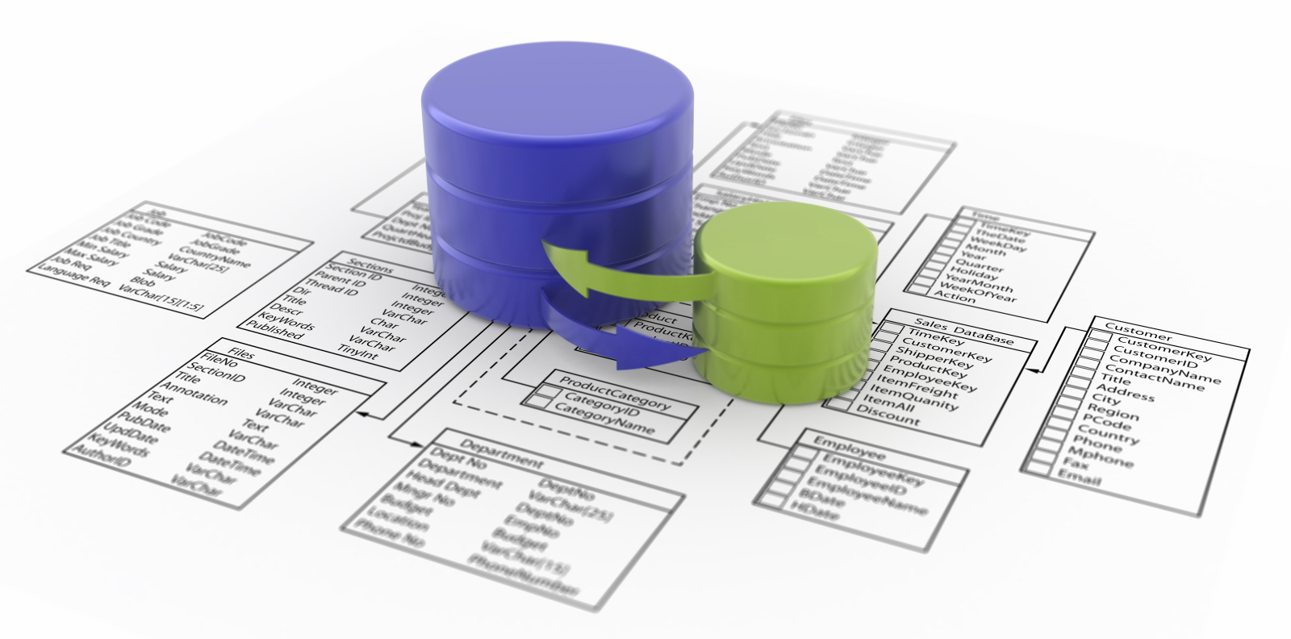
SQL Server 2012 for Business Intelligence
UTS Short Course
Notes:
Click to add notes
Peter Gfader shows SQL Server

Slide 2
Daniel Hyles – SA @ SSW
w: dotnetdan.info | e: DanielHyles@ssw.com.au | t: @danielhyles
Loves C# and .NET
Specializes in
Application architecture and design
SQL Performance Tuning and Optimization
Agile, Scrum
Technology aficionado
ASP.NET
Windows Forms
Mobile Apps
Notes:
Solution Architect

Slide 3
Mehmet Ozdemir – SA @ SSW
w: blog.ozdemir.id.au | e: mehmet@ssw.com.au | t: @mozdemir_au
SQL Server, BI, Infrastructure
Specializes in
Application architecture and design
SQL Performance Tuning and Optimization
HyperV, SCVMM
Technology aficionado
Virtualization
Reporting/BI
Cubes

Slide 4
Course Website
http://sharepoint.ssw.com.au/Training/UTSSQL/Pages/default.aspx
Course Timetable
Course Materials

Slide 5
Course Overview
Session | Date | Time | Topic
1 | Tuesday 17-Sep-2013 | 18:00 - 21:00 | SSIS and Creating a Data Warehouse
2 | Tuesday 24-Sep-2013 | 18:00 - 21:00 | OLAP – Creating Cubes and Cube Issues
3 | Tuesday 01-Oct-2013 | 18:00 - 21:00 | Reporting Services
4 | Tuesday 08-Oct-2013 | 18:00 - 21:00 | Alternative Cube Browsers
5 | Tuesday 15-Oct-2013 | 18:00 - 21:00 | Data Mining
Notes:
Cube - explain
SSIS - explain

Slide 6
Last week
Business Intelligence
Data Warehouse
Measure (Facts)
Dimension
ETL
SSIS
Notes:
ETL?
What can you do with SSIS?

Slide 7
Homework
What is a "TYPE"?
Why?
06_DWCreateScript.sql: What does the stored procedure "procDimDateInsert" do?
What is the difference
TRUNCATE
DELETE FROM?
SSIS: What for is the Sequence Container?
Notes:
Create TYPE command is used to create an alias data type or user defined type in the database. Once the type is created it is added to the list of available data types.
The type can be used to define database objects, table columns, parameters of functions and stored procedures.
---
Procedure procDimDateInsert inserts dates from 1/01/1990 to 01/2020 in various formats like date, day number of week, name of week, day number of month, day number of year, week number of year, month name, month number of year, calendar quarter, calendar year, Fiscal Quarter, Fiscal year into DimDate table.
---
" Truncate use less transaction log space. It is faster compared to delete statement.
" The DELETE removes rows one at a time and records an entry in the transaction log for each deleted row.
" Truncate use fewer locks. Truncate locks the table and pages but not rows. Delete locks each row.
" Truncate leaves zero pages in the table. After delete table contains empty pages.
" TRUNCATE TABLE cannot be used on tables that are referenced by a FOREIGN KEY constraint or part of an indexed view.
" You cannot use a trigger on truncate statement. Trigger can be used for deletion operation.
---
The sequence container gives the ability to group tasks which need to precede other tasks. Series of tasks can be created within the container. Multiple tasks can be managed easily by setting property on container. Variable defined in the scope of container can be used by related group of tasks. It gives you the ability to disable group of tasks and debug one subset of package control flow.

Slide 8

Cubes

Slide 9
Session 2: Tonight’s Agenda
What is a Cube?
Steps in Creating a Cube
Demo: Creating a Cube
Cube Issues
Hands on Lab

Slide 10
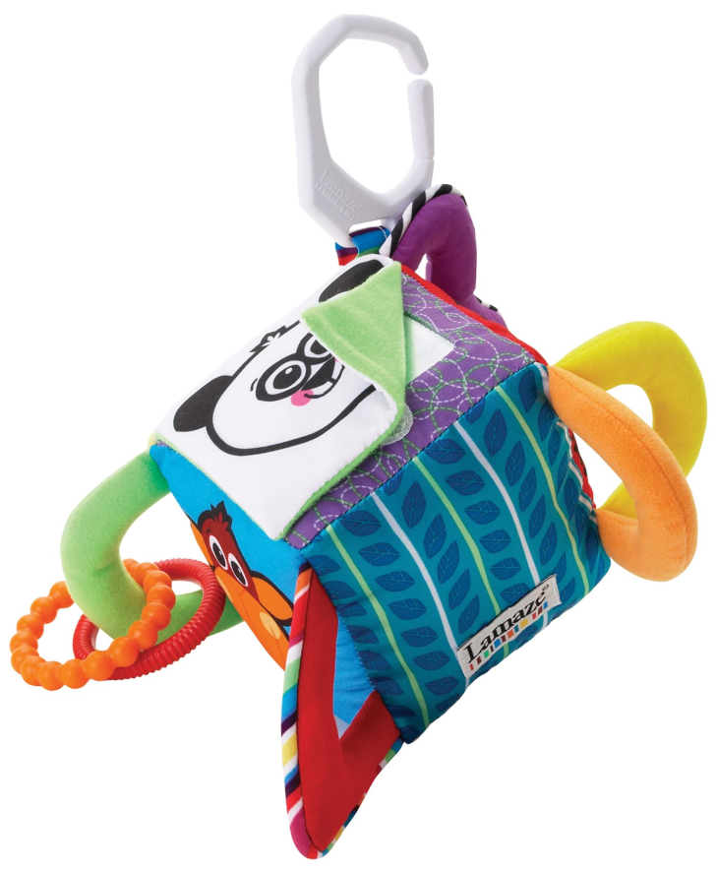
Cubes

Slide 11
Cube
Data structure for fast analysis of data
Precalculated
On top of a data warehouse
Manipulating and analysing data
from multiple perspectives
Notes:
cube is a data structure that allows fast analysis of data
It can also be defined as the capability of manipulating and analyzing data from multiple perspectives.

Slide 12
Why a cube?
Performance
Relational databases not suited for instantaneous analysis
Cube precalculates (aggregates) data
Notes:
Relational databases not suited for instantaneous analysis and display of large amounts of data
Instead, they are better suited for creating records from a series of transactions known as OLTP or On-Line Transaction Processing.^{[2]} Although many report-writing tools exist for relational databases, these are slow when the whole database must be summarized.

Slide 13
Cube Concept
Groceries
Electronics
Product
Clothing
North
South
Garden
East
Automotive
Geog
West
Q1 Q2 Q3 Q4
Time

Slide 14
Edges are Dimensions
North
South
East
West

Slide 15
Groceries
North
Q4
Notes:
Yellow is measure.

Slide 16
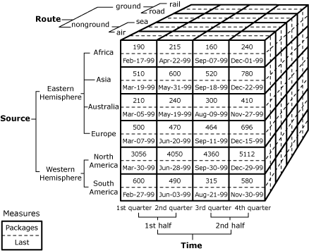
„Import“ cube example
Sum over Packages
Max over Last
Notes:
Sum over Packages
Max over Last
The Imports cube contains 2 measures,
Packages and
Last
and 3 related dimensions,
1 . Route
2. Source, and
3. Time.

Slide 17
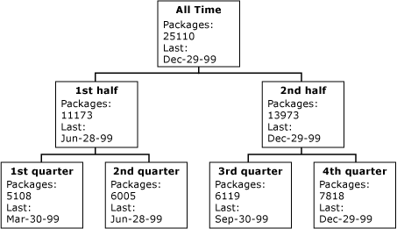
Aggregate measures over time dimension
Attribute hierarchy
Notes:
View data over time. How we going as a business
SQL only really shows you what is happening now
See last year on this year. Last years print out may have had a different query
Spend time on this

Slide 18
Aggregate measures by multi dimensions
 |  |  | Packages |  |  | Last
 |  |  | All Sources | Eastern Hemisphere | Western Hemisph. | All Sources | Eastern Hemisph. | Western Hemisph.
All Time |  |  | 25110 | 6547 | 18563 | Dec-29-99 | Dec-22-99 | Dec-29-99
 | 1st half |  | 11173 | 2977 | 8196 | Jun-28-99 | Jun-20-99 | Jun-28-99
 |  | 1st quarter | 5108 | 1452 | 3656 | Mar-30-99 | Mar-19-99 | Mar-30-99
 |  | 2nd quarter | 6065 | 1525 | 4540 | Jun-28-99 | Jun-20-99 | Jun-28-99
 | . . . .
Notes:
In addition to aggregating measures by using a single dimension, you can aggregate measures by using combinations of members from different dimensions. This allows business users to evaluate measures in multiple dimensions simultaneously. For example, if a business user wants to analyze quarterly imports that arrived by air from the Eastern Hemisphere and Western Hemisphere, the business user can issue a query on the cube to retrieve the following dataset.

Slide 19
Why a cube?
Performance
Relational databases not suited for instantaneous analysis
Cube precalculates (aggregates) data
KPI and trending
Notes:
Relational databases not suited for instantaneous analysis and display of large amounts of data
Instead, they are better suited for creating records from a series of transactions known as OLTP or On-Line Transaction Processing.^{[2]} Although many report-writing tools exist for relational databases, these are slow when the whole database must be summarized.
Not only that but people frown upon killing the production DB while making boring reports.

Slide 20
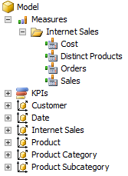
Adventure Works example
A cube is an
“aggregation of measures against dimensions”

Slide 21
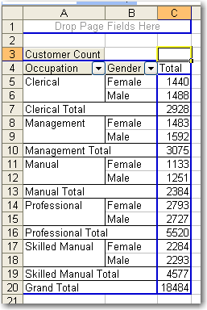
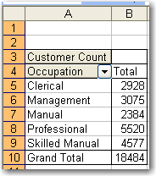
What is a Cube - Example

Slide 22
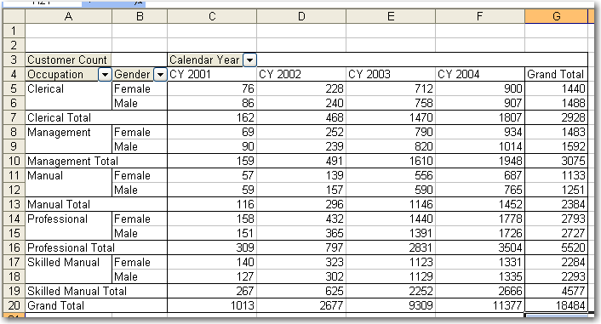
What is a Cube - Example

Slide 23
What is a Cube in SQL 2012
Data Source
Where the data comes from
Adventure works connection string
Data Source View
The tables and how they link together
Orders, Details, Products and relationships
Name matching to detect relationships
Dimensions
How we break up the aggregate data
Products, Time
Measures (Facts)
The aggregate data
Line Total, Quantity

Slide 24

New type of Cube
SQL 2012 brings a new cube model called Tabular
Advantages
Faster
Easier to create
Disadvantages
New
Limited to the RAM on server
Notes:
Adv
- More performant than OLAP in majority of the case (in memory)
- Easier to develop than Multidimensional model
- Technology for the future
Integration with Power Pivot
Dis
- New product so still enhancements to come
- Limited to RAM available (= midsized project)
- Missing some advanced computations available with MDX
Technet Comparison:
http://technet.microsoft.com/en-us/library/hh212940.aspx
MSDN Paper:
http://msdn.microsoft.com/en-us/library/hh994774.aspx

Slide 25

Steps in Creating a Cube
Define Data Source
Create Data Source View
Define Dimensions
Define Measures (Facts)
Process the Cube
Notes:
Do the lab

Slide 26
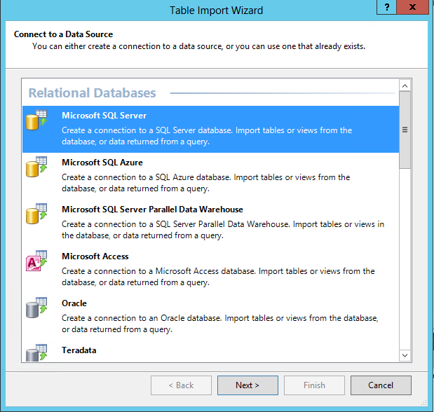
Data Source - Database
Notes:
We have the ability to connect to basically any sort of data source.
Including RSS feeds, excel documents and text files

Slide 27
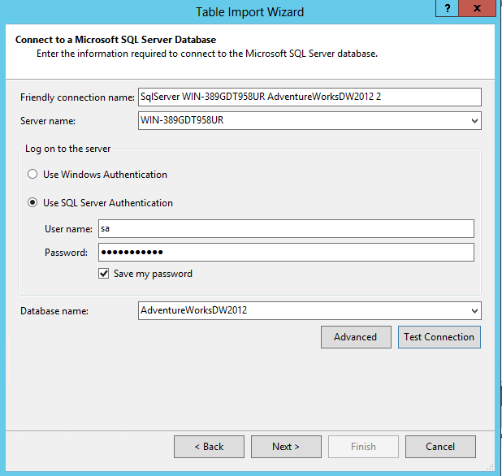
Data Source - Impersonation (Authentication)

Slide 28
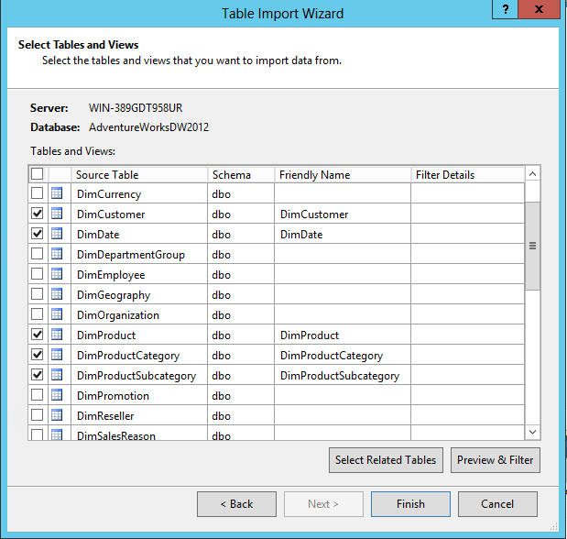
Data Source View – Select Tables and Views
Notes:
It will bring across the relationships automatically from the DB

Slide 29
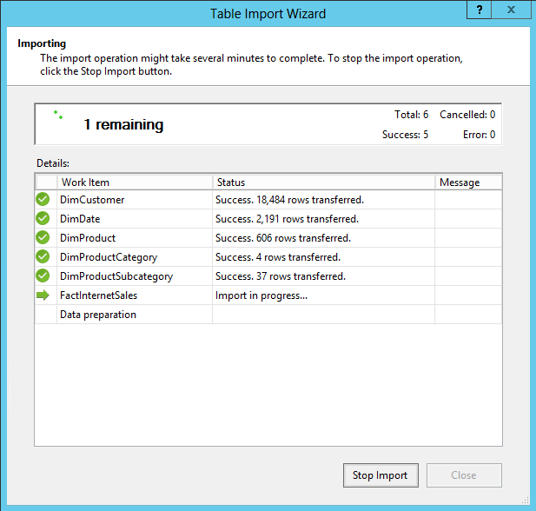
Build a Cube – Finish the wizard

Slide 30
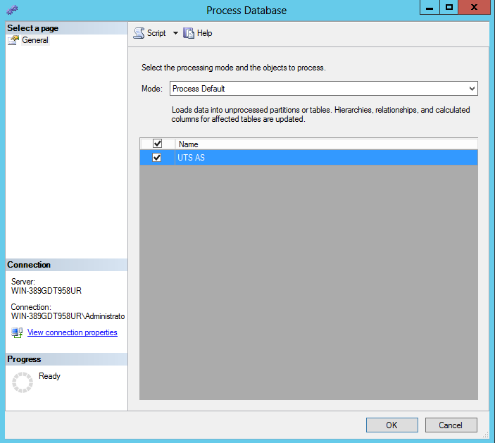
Build a Cube – Process Cube

Slide 31
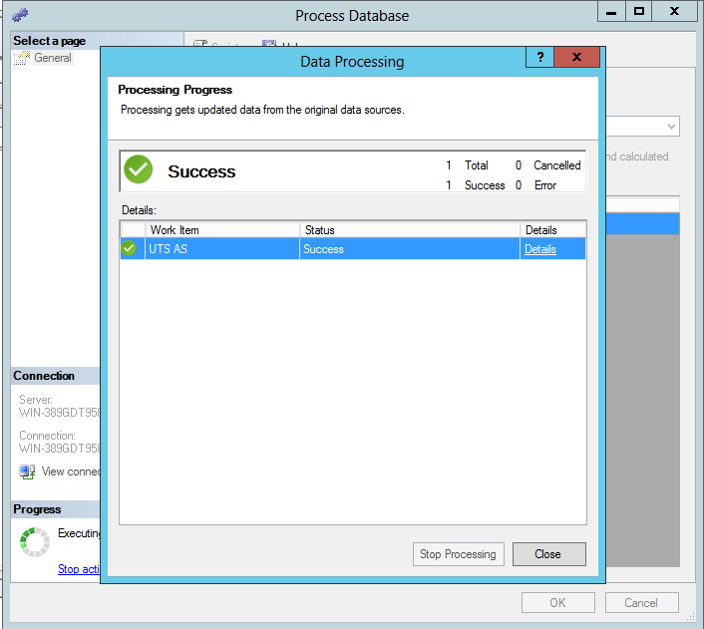
Build a Cube – Process Cube

Slide 32

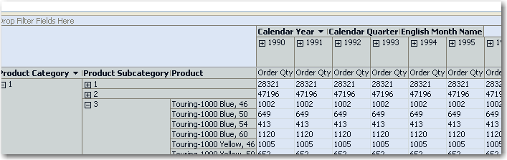
Build a Cube
Review Auto Generated Cube
Check Hierarchies e.g. Product Category shows ID rather than name
Notes:
The auto generated cube will not automatically setup the measures in the tabular model. We have to manually go in and make changes.
????? TODO

Slide 33
Cube Issues
Keeping things Related
Dimensions should tie in to Fact tables
Use Primary Keys
Keeping things Relevant
Multiple fact tables
Even more dimensions
Keeping things Fresh
Needs to be processed
Automated SSIS Packages
Keeping Missing Data
Fails to process when keys are missing
Change missing keys to Unknown
Notes:
Link between dimension / facts (performance tooo)
Missing foreign key
Make missing keys unknown

Slide 34
Common Patterns
Inserting null records to prevent invalid key lookups (slows down cube processing significantly)
Cube is based off views (can be changed easily)
Can combine data using partitions
Notes:
Link in a RSS feed to the data by manually setting up relationships

Slide 35
MOLAP vs ROLAP
Multidimensional Online Analytical Processing
Relational Online Analytical Processing
Notes:
MOLAP – Not live?
ROLAP – live? (SLOW) TODO in 2012?

Slide 36


MOLAP
ROLAP
Fast query performance
Consumes less disk space
Auto aggregation of data
Processing can be slow
Works well with large volumes of data
Real time
Securable
Slower than MOLAP
Need to create your own aggregations
Not suited for budgeting and forecasting

Slide 37
Best Practices - Dimensions
Consolidate multiple hierarchies into a single dimension
Avoid ROLAP storage model
Use role playing dimensions (e.g. OrderDate, BillDate, ShipDate) – avoids multiple physical copies (use a view to make it look nicer) (http://www.youtube.com/watch?v=SCH5gMCHMZs)
Avoid Many-to-Many dimensions (slow)
Notes:
http://blogs.msdn.com/b/jbasilico/archive/2008/04/01/analysis-services-2005-design-best-practices-cubes-mdx.aspx
Role Playing Dimension:
http://www.youtube.com/watch?v=SCH5gMCHMZs

Slide 38
Best Practices – Attributes/Hierachies
Define all possible attribute relationships
Remove redundant attribute relationships
Use integer (or numeric) key columns

Slide 39
Best Practices - Measures
Use smallest numeric data type possible
Use semi-additive aggregate functions instead of MDX calculations to achieve same behaviour
Avoid string source column for distinct count measures

Slide 40
Best Practices - OLAP
No more than 20M rows per partition
Manage storage settings by usage patterns
Frequently queried => MOLAP with lots of aggregations
Periodically queries => MOLAP with less or no aggregations
Historical => ROLAP with no aggregations
Use multiple disk controllers for IO performance (Use SQLIO to determine disk perf)
Notes:
SQL IO Download:
http://www.microsoft.com/en-au/download/details.aspx?id=20163
SQLIO Tutorial:
http://www.brentozar.com/archive/2008/09/finding-your-san-bottlenecks-with-sqlio/

Slide 41
Best Practices - General
Create Perspectives to help with querying data
Create Measure Groups
Create Calculated Measures and KPIs for frequently analysed data – if you can do it in the DSV that’s preferable
Notes:
Perspectives:
http://technet.microsoft.com/en-us/library/ms175338.aspx
Measure Groups:
http://technet.microsoft.com/en-us/library/ms174792.aspx

Slide 42
MDX
MultiDimensional EXpressions

Slide 43
Syntax
SELECT { <Measure>,…} ON COLUMNS, { <Dimension> } ON ROWS
FROM <Cube>
WHERE (<Filters>)

Slide 44
Our data
SELECT
FROM [Adventure Works]
WHERE [Measures].[Internet Order Count]

Slide 45

Internet Orders

Slide 46
Slicing our data – 2007 Q1
SELECT FROM [Adventure Works] WHERE ( [Measures].[Internet Order Count], [Date].[Fiscal].[Fiscal Quarter].&[2007]&[1] )

Slide 47

Internet Orders in 2007 Q1
2007 Q1

Slide 48
Slicing our data – 2007 Q1, Australia
SELECT FROM [Adventure Works] WHERE ( [Measures].[Internet Order Count], [Date].[Fiscal].[Fiscal Quarter].&[2007]&[1], [Customer].[Customer Geography].[Country].&[Australia] )

Slide 49

Internet Orders in 2007 Q1, Australia
Australia
2007 Q1

Slide 50
Slicing our data – 2007 Q1, Australia
SELECT FROM [Adventure Works] WHERE ( [Measures].[Internet Order Count], [Date].[Fiscal].[Fiscal Quarter].&[2007]&[1], [Customer].[Customer Geography].[Country].&[Australia], [Customer].[Gender].&[M] )

Slide 51

Internet Orders in 2007 Q1, Australia, Male
Australia
M
2007 Q1

Slide 52
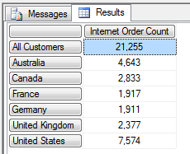
Syntax
SELECT {[Measures].[Internet Order Count]} ON COLUMNS,
{[Customer].[Country].Members} ON ROWS
FROM [Adventure Works]
WHERE [Date].[Fiscal Year].&[2008]

Slide 53
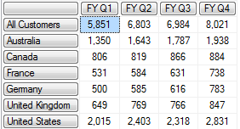
Syntax
SELECT {[Date].[Fiscal Quarter of Year].[Fiscal Quarter of Year].Members} ON COLUMNS, {[Customer].[Country].Members} ON ROWS FROM [Adventure Works] WHERE [Measures].[Internet Order Count]

Slide 54
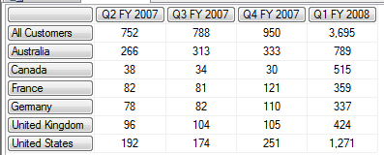
Syntax – Get me the last 4 quarters
SELECT {LastPeriods(4,[Date].[Fiscal].[Fiscal Quarter].&[2008]&[1])} ON COLUMNS, {[Customer].[Country].Members} ON ROWS FROM [Adventure Works] WHERE [Measures].[Internet Order Count]

Slide 55
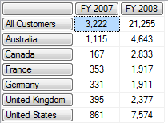
Syntax – How did we do last year?
SELECT {ParallelPeriod([Date].[Fiscal].[Fiscal Year], 1,[Date].[Fiscal].[Fiscal Year].&[2008]),
[Date].[Fiscal].[Fiscal Year].&[2008]} ON COLUMNS,
{[Customer].[Country].Members} ON ROWS
FROM [Adventure Works]
WHERE [Measures].[Internet Order Count]

Slide 56
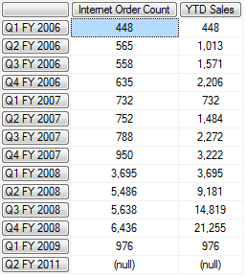
Syntax - YTD
WITH MEMBER [Measures].[YTD Sales] AS 'SUM(PeriodsToDate([Date].[Fiscal].[Fiscal Year]), [Measures].[Internet Order Count])‘ SELECT {[Measures].[Internet Order Count],[Measures].[YTD Sales] } ON COLUMNS, {[Date].[Fiscal].[Fiscal Quarter]} ON ROWS FROM [Adventure Works]

Slide 57
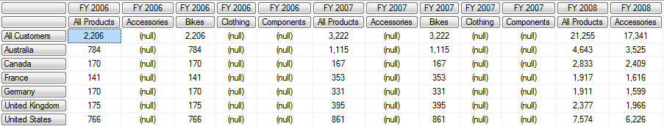
Syntax – Cross Joins
SELECT {CROSSJOIN([Date].[Fiscal].[Fiscal Year], [Product].[Category].MEMBERS)} ON COLUMNS, {[Customer].[Country].MEMBERS} ON ROWS FROM [Adventure Works] WHERE [Measures].[Internet Order Count]

Slide 58
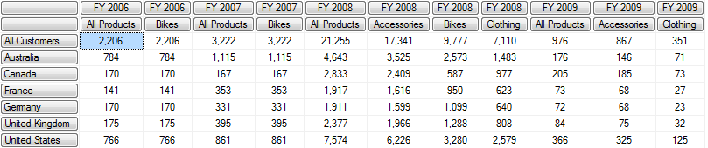
Syntax – Cross Joins
SELECT {NONEMPTYCROSSJOIN([Date].[Fiscal].[Fiscal Year], [Product].[Category].MEMBERS)} ON COLUMNS, {[Customer].[Country].MEMBERS} ON ROWS FROM [Adventure Works] WHERE [Measures].[Internet Order Count]

Slide 59
The Equivalent in SQL?
SELECT c.Name Country, DATEPART(yyyy, sh.OrderDate) [Year], pc.Name Category, SUM(sd.OrderQty) TotalOrders FROM Sales.SalesOrderDetail sd INNER JOIN Sales.SalesOrderHeader sh ON sh.SalesOrderID = sd.SalesOrderID INNER JOIN Production.Product p ON sd.ProductID = p.ProductID INNER JOIN Production.ProductSubCategory psc ON psc.ProductCategoryID = p.ProductSubcategoryID INNER JOIN Production.ProductCategory pc ON pc.ProductCategoryID = psc.ProductCategoryID INNER JOIN Person.Address a ON a.AddressID = sh.ShipToAddressID INNER JOIN Person.StateProvince sp ON sp.StateProvinceID = a.StateProvinceID INNER JOIN Person.CountryRegion c ON c.CountryRegionCode = sp.CountryRegionCode GROUP BY c.Name, DATEPART(yyyy, sh.OrderDate), pc.Name ORDER BY c.Name, pc.Name, DATEPART(yyyy, sh.OrderDate)

Slide 60
The Equivalent in SQL?
What about fiscal year?

Slide 61
The Equivalent in SQL?
SELECT c.Name Country, CASE WHEN MONTH(sh.OrderDate) < 7 THEN YEAR(sh.OrderDate) - 1 ELSE YEAR(sh.OrderDate) END [Year], pc.Name Category, SUM(sd.OrderQty) TotalOrders FROM Sales.SalesOrderDetail sd INNER JOIN Sales.SalesOrderHeader sh ON sh.SalesOrderID = sd.SalesOrderID INNER JOIN Production.Product p ON sd.ProductID = p.ProductID INNER JOIN Production.ProductSubCategory psc ON psc.ProductCategoryID = p.ProductSubcategoryID INNER JOIN Production.ProductCategory pc ON pc.ProductCategoryID = psc.ProductCategoryID INNER JOIN Person.Address a ON a.AddressID = sh.ShipToAddressID INNER JOIN Person.StateProvince sp ON sp.StateProvinceID = a.StateProvinceID INNER JOIN Person.CountryRegion c ON c.CountryRegionCode = sp.CountryRegionCode
Notes:
Spills over to second page

Slide 62
The Equivalent in SQL?
GROUP BY c.Name, CASE WHEN MONTH(sh.OrderDate) < 7 THEN YEAR(sh.OrderDate) - 1 ELSE YEAR(sh.OrderDate) END, pc.Name ORDER BY c.Name, pc.Name, CASE WHEN MONTH(sh.OrderDate) < 7 THEN YEAR(sh.OrderDate) - 1 ELSE YEAR(sh.OrderDate) END

Slide 63
XMLA (XML for Analysis)
Another way to query your Cube
SOAP-based XML protocol, designed specifically for universal data access to any standard multidimensional data source that can be accessed over an HTTP connection.
Analysis Services uses XMLA as its only protocol when communicating with client applications.

Slide 64

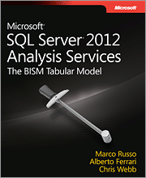
MDX and XMLA is hard
Microsoft SQL Server 2012 Analysis Services: The BISM Tabular Model
Professional Microsoft SQL Server 2012 Analysis Services with MDX and DAX
Notes:
Data Analysis Expressions, or DAX, is the native formula and query language for Microsoft PowerPivot and SQL Server Analysis Services Tabular models. DAX includes some of the functions that are used in Excel formulas, and additional functions that are designed to work with relational data and perform dynamic aggregation. It is, in part, an evolution of the Multidimensional Expression (MDX) language developed by Microsoft for Analysis Services multidimensional models (often called cubes) combined with Excel formula functions. It is designed to be simple and easy to learn, yet to expose the power and flexibility of PowerPivot and SSAS tabular models.

Slide 65
Summary
What is a Cube?
Steps in Creating a Cube
Demo: Creating a Cube
Cube Issues
Hands on Lab

Slide 66
Tips
http://www.ssw.com.au/ssw/standards/Rules/RulesToBetterBusinessIntelligence.aspx
http://channel9.msdn.com/tags/Data+Warehousing/
http://channel9.msdn.com/tags/Business+Intelligence/
http://sqlblog.com/blogs/default.aspx

Slide 67
SSIS resources
SSIS Junkie http://sqlblog.com/blogs/jamie_thomson
Microsoft SQL Server Integration Services ON-DEMAND WEBCASTS http://www.microsoft.com/events/series/bi.aspx?tab=webcasts&id=42664
Great blog about SSIS http://www.sqlis.com/sqlis/

Slide 68
Resources
Newsletter http://www.sqlservercentral.com/
BIDS helper http://www.codeplex.com/bidshelper
Notes:
A Visual Studio.Net add-in with features that extend and enhance the functionality of the SQL Server 2005 and SQL Server 2008 BI Development Studio (BIDS).
Install business intelligence helper

Slide 69

3 things…
DanielHyles@ssw.com.au
http://dotnetdan.info
twitter.com/danielhyles

Slide 70
3 things…
mehmet@ssw.com.au
http://blog.ozdemir.id.au
twitter.com/mozdemir_au

Slide 71

Thank You!
Gateway Court Suite 10 81 - 91 Military Road Neutral Bay, Sydney NSW 2089 AUSTRALIA
ABN: 21 069 371 900
Phone: + 61 2 9953 3000 Fax: + 61 2 9953 3105
info@ssw.com.au www.ssw.com.au

